Slide 1
Introduction to Class Imbalance
The irregular data distribution between classes is referred to as Class imbalance.
In simple terms, it can be said that when the class contains disproportionate number of instances
i.e. having more specimens in one sub-dataset than the other.
Class imbalance refers to the non uniformity in the class distribution, which means that there are many examples in one class and few in other classes
This is a scenario where the number of observations belonging to one class is significantly lower than those belonging to the other classes.

Slide 2
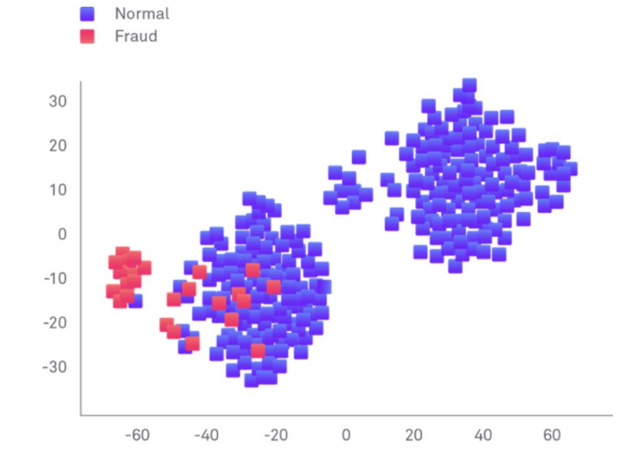

Slide 3
For Numerical Example:
In an utility fraud detection data set you have the following data:
▪ Total Observations = 1000
▪ Fraudulent Observations = 20
▪ Non Fraudulent Observations = 980

Slide 4
Many classifiers are designed to optimize error/accuracy
This tends to bias performance towards the majority class
Anytime there is an imbalance in the data this can happen
An imbalanced classification problem is an example of a classification problem where the distribution of examples across the known classes is biased or skewed.

Slide 5
Decision trees:
• explicitly minimizes training error
• when pruning pick “majority” label at leaves
• tend to do very poor at imbalanced problems
k-NN:
• even for small k, majority class will tend to overwhelm the vote
perceptron:
• can be reasonable since only updates when a mistake is made
• can take a long time to learn

Slide 6
Class imbalance- How to deal
Model-level: Models can be modified to introduce heavier weighting to smaller representative
classes, penalizing more heavily errors in training prediction
• Evaluation-level: Alternative evaluation metrics must be used to account for class balance –
note that this solves only the problem of performance evaluation, it does not actually lead to
better model classification.
• Data-level: Alternatively, the data itself can be transformed. If done in a smart way, new
instances can be introduced in such a way to allow models to better model these classes. These
methods fall under the name of data samplers (or data sampling related algorithms).

Slide 7
A widely adopted technique for dealing with highly unbalanced datasets is called resampling.
1. Removing samples from the majority class (under-sampling).
2. Adding more examples to the minority class (over-sampling).
3. Or perform both simultaneously:
• Under-Sample the majority &
• Over-Sample the minority

Slide 8
Since Random Oversampling has disadvantages we pay attention to yet another technique called SMOTE
Synthetic Minority Oversampling Technique (SMOTE)
SMOTE not only increases the size of the training data set, it also increases the variety.
SMOTE creates new (artificial) training examples based on the original training examples
For an imbalanced dataset, first SMOTE is applied to create new synthetic minority samples to get a balanced distribution.

Slide 9
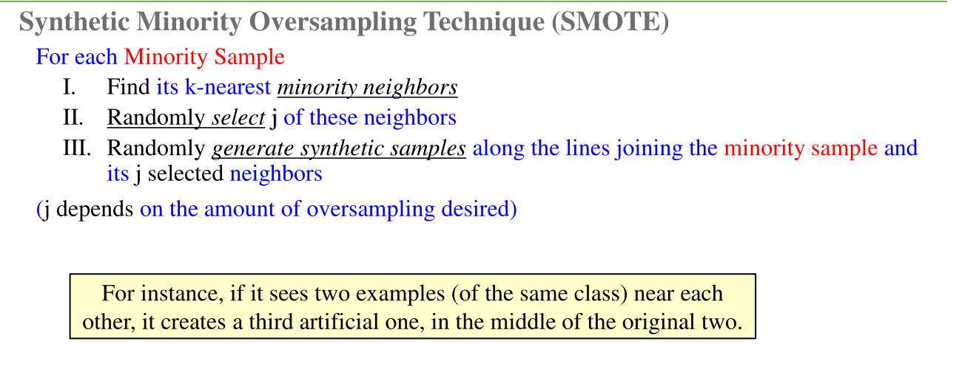
The newly generated sample resembles and inherits characteristics of its neighbors

Slide 10
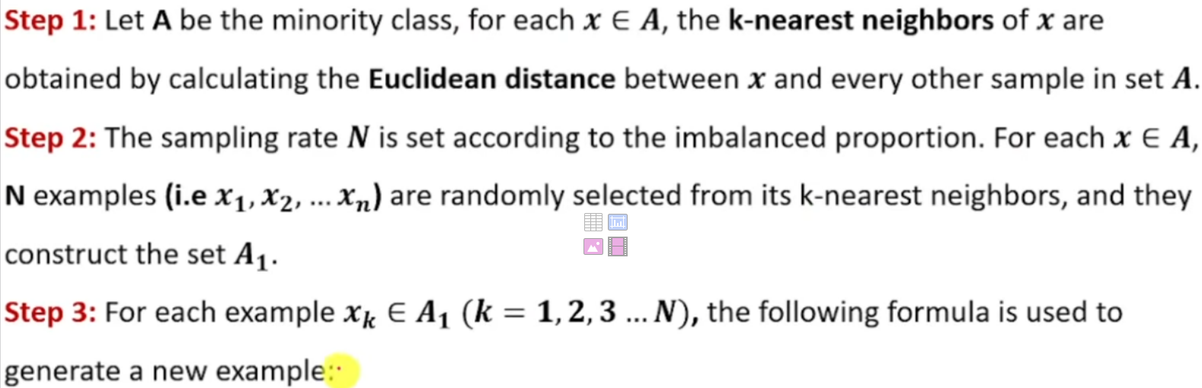
SMOTE

Slide 11
At a high level, the SMOTE algorithm can be described as follows:
Take difference between a sample and its nearest neighbour
Multiply the difference by a random number between 0 and 1
Add this difference to the sample to generate a new synthetic example in feature space
Continue on with next nearest neighbour up to user-defined number

Slide 12
SMOTE creates new synthetic points between existing minority samples.
Formula:
xnew​ = xi​ + r×(xnn​−xi​)
Where:
xi​ = minority sample
xnn​ = nearest minority neighbor
r = random number between 0 and 1
SMOTE does not always use only the single nearest neighbor.
It chooses from k nearest neighbors.
k controls neighbor selection , n controls number of synthetic samples generated.
Different random numbers be used in the synthetic sample generation. (during implementation, random numbers generated automatically)

Slide 13
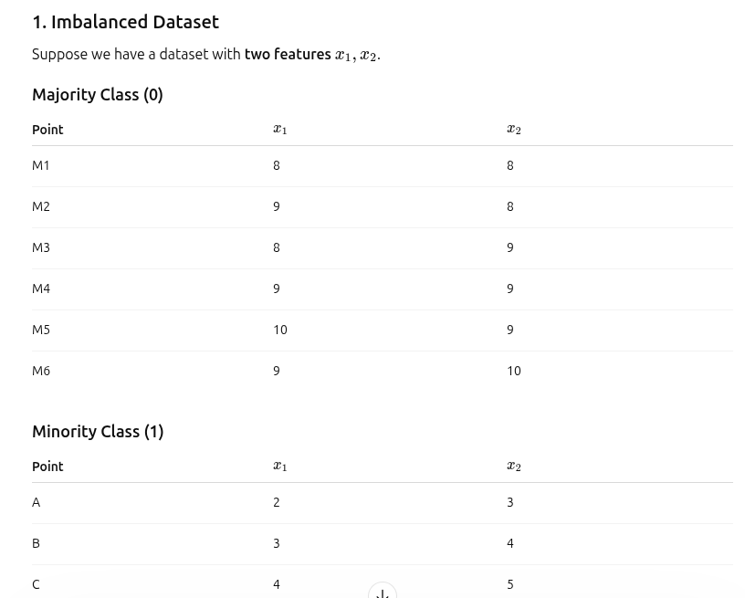

Slide 14
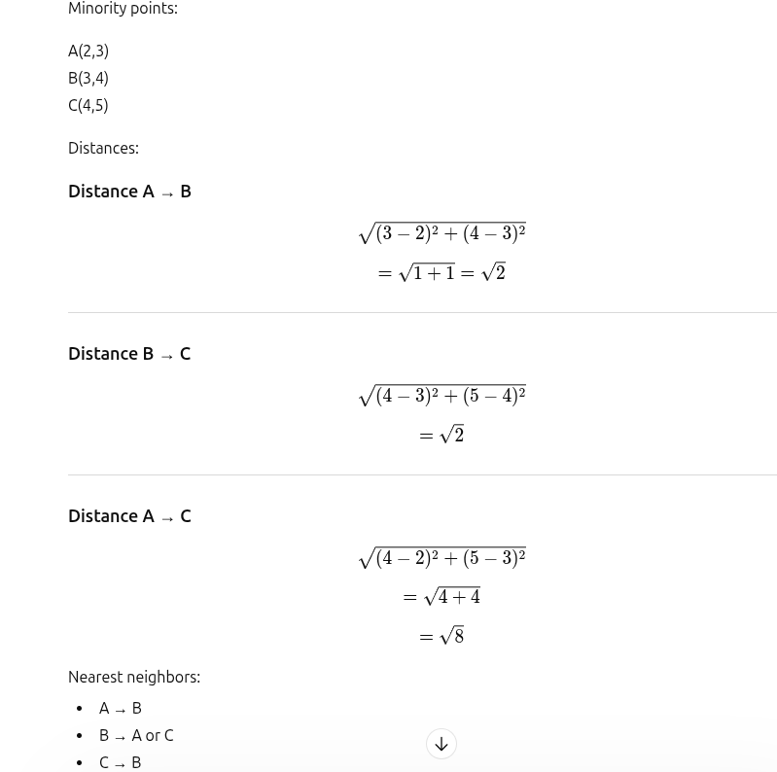

Slide 15
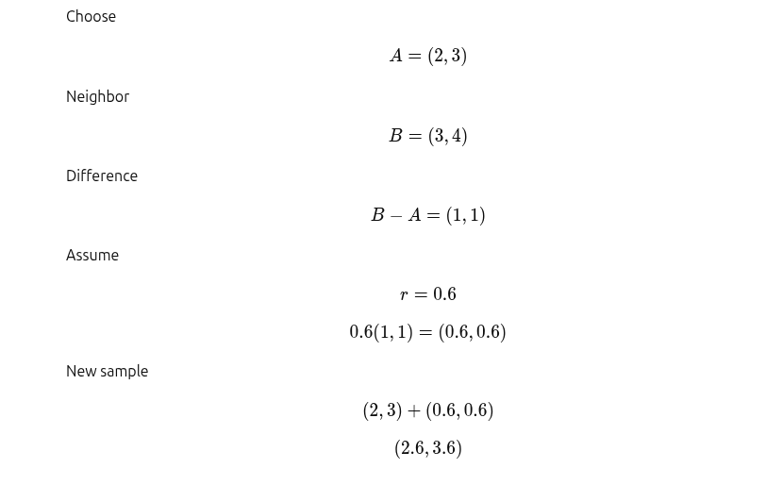
Synthetic sample 1

Slide 16
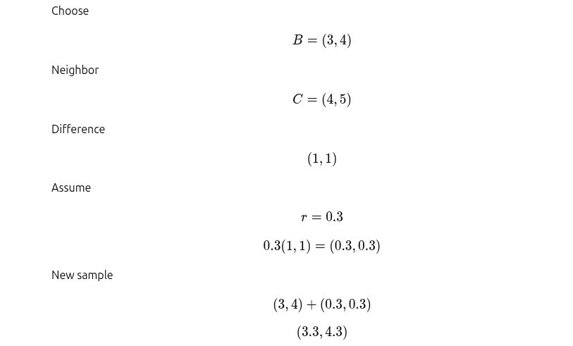
Synthetic sample 2

Slide 17
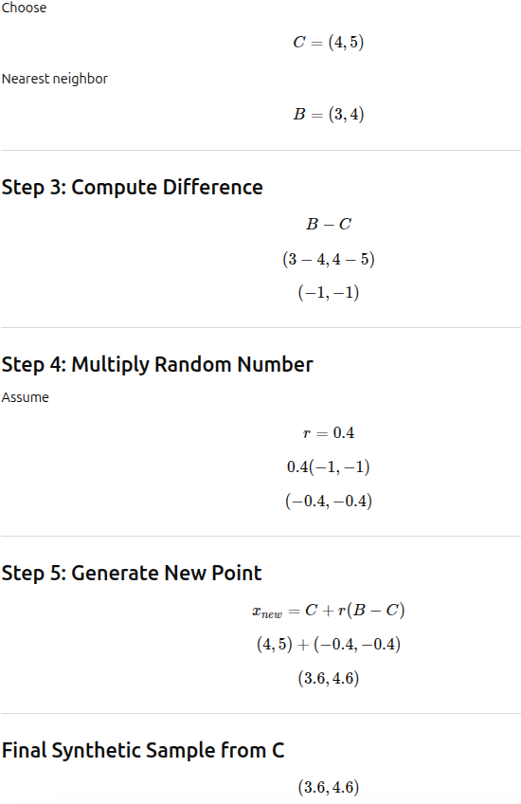
Synthetic sample 3

Slide 18
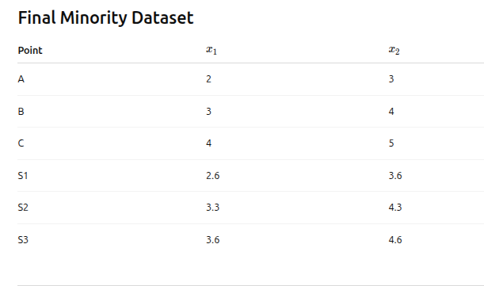

Slide 19
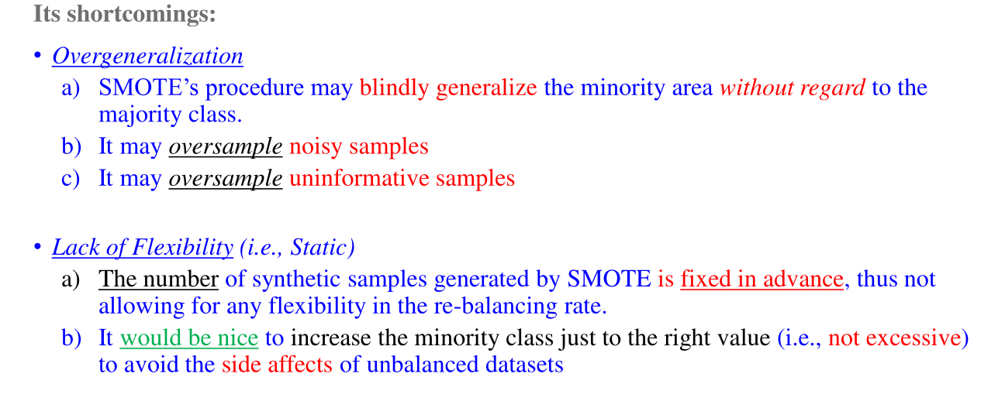

Slide 20
